Slide 1
How can we increase revenue
from
Catch the Pink Flamingo?
Yazan Hossam Hossam Aldeen

Slide 2
Problem Statement
Use available data and applied analytics in order to identify new revenue
opportunities and gain insight into the behavior of players among each other.
Data source:
Players activities.
Chats between players.
Notes:
Fill in appropriate data set descriptions.
In your script, be sure to make clear how this is a data science story. State in your own words YOUR opinion of why the different kinds and sources of data are so important for Eglence to be able to identify new revenue opportunities.

Slide 3
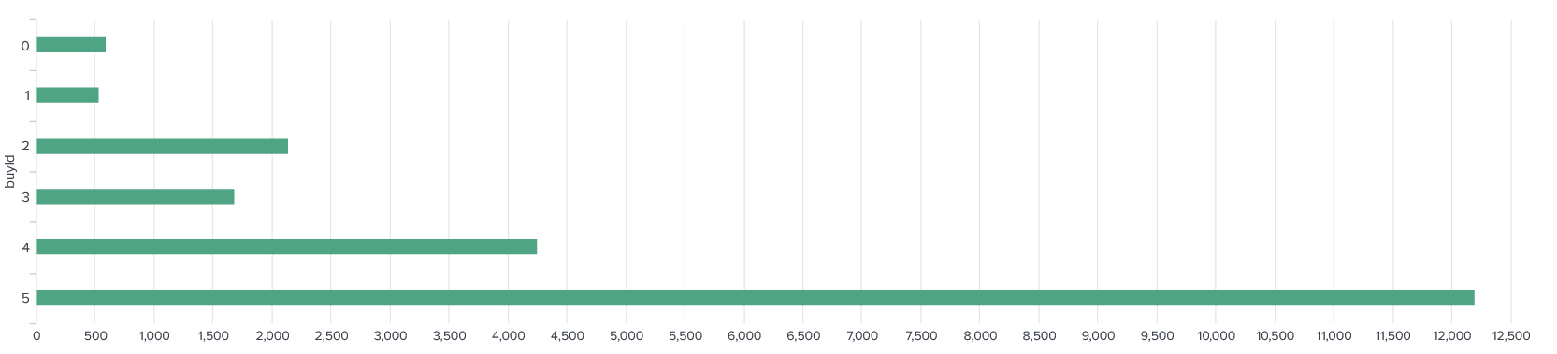
Data Exploration Overview
Revenue generated from in-app purchase item.
buyId 5 generate between 55% and 60% of total revenue
More than all items companied.
Notes:
Assuming you have <2 minutes for this slide, what is the most important thing(s) to convey from your experience with exploring the data?

Slide 4
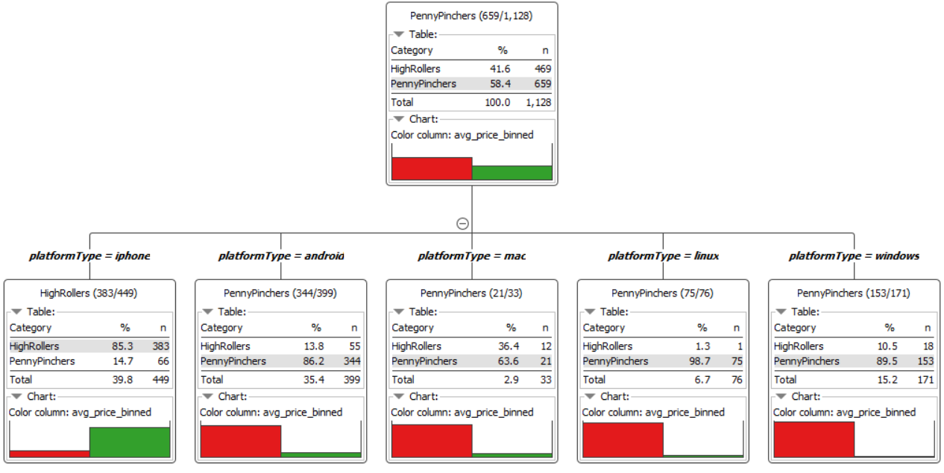
What have we learned from classification?
Eyes on the iphone.
Notes:
Assume you have 2 minutes to present what you perceive to be the most important or remarkable points from your classification analysis.

Slide 5
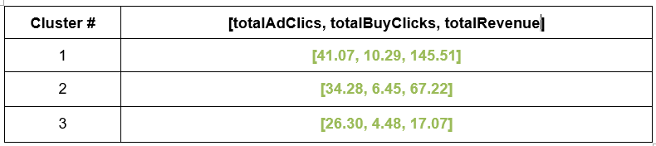
What have we learned from clustering?
totalAdClics: total number of add-clicks per user.
totalBuyClicks: total number of in-app purchase per user.
totalRevenue: total monny spent on in-app purchase item per user.
Notes:
Assume you have 2 minutes to present what you perceive to be the most important or remarkable points from your classification analysis.

Slide 6
Graph analytics on chat data
Found the longest conversation chain and it’s participants.
Analyzed relationship between top 10 chattiest user and top 10 chattiest teams.
Fount the top 3 most active users based on clustering coefficient.
Notes:
Assume you have 2 minutes to present what you perceive to be the most important or remarkable points from your graph analysis

Slide 7
Recommendation
Focus in selling and developing in-app purchase item like the buyId 5.
Promoting the game attract more iOS and Mac users.
Target specific group of player obtained from the results of the clustering and graph analytics that we have.
Notes:
From your own viewpoint, make one recommendation/action the Eglence should follow to improve their business. Be sure to explain your rationale.

Slide 8
End of presentation
Thanks all for your good attention and caring.
My fully regards and respects.

